Slide 1

Analyst Presentation August 13, 2014

Slide 2
Agenda
Business Initiatives
Financial Performance
Results Standalone for Q1FY15
EBITDA Analysis
Sales Analysis
Brand Updates
Results Consolidated for Q1 FY15

Slide 3
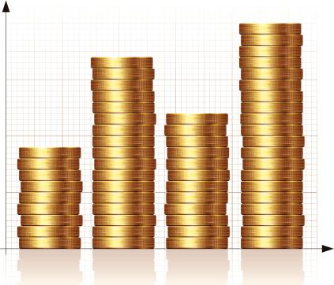
Financial Performance
Q1 FY15

Slide 4
Results – Standalone Profit & Loss
In Rs. Lacs
Particulars | Quarter Ended |  |  | Year Ended
 | 30.06.2014 | 31.03.2014 | 30.06.2013 | 31.03.2014
Net Sales | 35,489 | 32,991 | 31,965 | 1,25,511
Other Income - Operating | 34 | 350 | 96 | 507
Total Income | 35,523 | 33,341 | 32,061 | 1,26,018
Cost of Goods Sold | 18,702 | 18,876 | 16,811 | 67,660
Employee cost | 3,302 | 3,082 | 3,049 | 11,866
Advertisement and Sales Promotion expense | 3,746 | 3,960 | 3,868 | 13,536
Other expenditure | 4,318 | 4,082 | 3,472 | 16,247
EBITDA | 5,456 | 3,341 | 4,862 | 16,709
EBITDA % to Net Sales | 15.4% | 10.1% | 15.2% | 13.3%
Depreciation and Impairment | 623 | 426 | 403 | 1,690
Amortisation of Brand & Goodwill | 1,115 | 1,115 | 1,115 | 4,470
Finance Cost | 293 | 405 | 1,666 | 5,311
Other Income - Non Operating | 1,751 | 1,522 | 1,286 | 5,623
Profit Before Prior Period Item and tax | 5,176 | 2,917 | 2,963 | 10,860
Prior Period/Exceptional Item | - | - | 93 | 230
Profit before Tax | 5,176 | 2,917 | 2,870 | 10,630
Tax | - | - | - | 19
Profit After Tax | 5,176 | 2,917 | 2,870 | 10,611

Slide 5
Results – Consolidated Profit & Loss
In Rs. Lacs
Particulars | Quarter Ended |  |  | Year Ended
 | 30.06.2014 | 31.03.2014 | 30.06.2013 | 31.03.2014
Net Sales | 38,514 | 35,594 | 33,258 | 1,31,839
Other Income - Operating | 34 | 393 | 96 | 547
Total Income | 38,548 | 35,987 | 33,353 | 1,32,387
Cost of Goods Sold | 20,119 | 20,218 | 16,918 | 69,438
Employee cost | 3,854 | 3,572 | 3,525 | 13,815
Advertisement and Sales Promotion expense | 4,211 | 4,426 | 4,006 | 14,421
Other expenditure | 5,164 | 4,796 | 4,118 | 18,991
EBITDA | 5,199 | 2,974 | 4,787 | 15,721
EBITDA % to Net Sales | 13.5% | 8.4% | 14.4% | 11.9%
Depreciation and Impairment | 811 | 621 | 571 | 2,432
Finance Cost | 337 | 457 | 1,721 | 5,527
Other Income - Non Operating | 197 | 287 | 144 | 818
Profit Before Prior Period Item and tax | 4,248 | 2,184 | 2,638 | 8,580
Prior Period/Exceptional Item | - | 21 | 164 | 395
Profit before Tax | 4,248 | 2,162 | 2,474 | 8,185
Tax | 6 | 14 | 11 | 64
Profit from ordinary activities before minority Interest | 4,242 | 2,148 | 2,463 | 8,121
Minority Interest (share in loss) | 5 | (3) | 6 | 22
Profit After Tax | 4,246 | 2,145 | 2,469 | 8,143

Slide 6
Highlights for Q1 FY2015: Consolidated
Sales growth of 16% (8% by volume and 8% by value)
Advt. & Sales Promo exp. for the quarter Rs 42 crore Increase of 5.1%.
A&P to Sales Ratio 10.9%.
EBITDA at Rs. 5199 lacs as compared to Rs 4787 lacs in last year same period
Gross Margin stands at 48% as compared to 49% in last year same period
PAT stands at Rs. 4246 lacs as compared to 2469 lacs in last year same period
Cash Profit for the quarter at Rs 5058 lacs
Media Investment positive; All POWER Brands in a growth trajectory.

Slide 7
Thrust on Regional Brands becoming National

Slide 8
EBITDA Analysis (Consolidated) – Q1FY15
EBITDA in Q1FY15 is 13.5% as compared to 14.4% in last year same period. The same is after spending 10.9% in Advertisement and sales promotion expenses.
This is mainly due to :
Reduction in Gross Margin by 1.4% due to
change in sales mix
Increase in other expenses by 1% of sales
Saving in Advertisement and promotion
expenses 1.1%

Slide 9
Consolidated EBITDA breakup
Rs in Lacs
Company Name | EBITDA
JLL | 5,456
JCPML | -155
JFSL | -149
JKBL | 3
AICPPL | 44
Consolidated EBITDA | 5,199

Slide 10
EBITDA Movement
In %
Particulars | Q1FY15 vs Q1FY14
EBITDA % - Previous period | 14.4
Other Operating Income | (0.2)
Gross Margin | (1.4)
Employee Cost | 0.6
Advertisement & Sales Promotion | 1.1
Other Expenditure | (1.0)
EBITDA % - Current period | 13.5

Slide 11
Sales Analysis
Segmentwise Sales Growth
Segment | Standalone |  |  | Consolidated
 | Q1FY15 | Q1FY14 | Growth % | Q1FY15 | Q1FY14 | Growth %
Soaps & Detergent | 29,225 | 25,454 | 15% | 30,452 | 25,766 | 18%
Home Care | 5,946 | 5,865 | 1% | 6,730 | 5,865 | 15%
Other Products | 604 | 785 | -23% | 601 | 790 | -24%
Total | 35,775 | 32,103 | 11% | 37,783 | 32,420 | 17%
Less: Inter Segment Revenue | -286 | -138 | - | -286 | -138 | -
Net FMCG Sales | 35,489 | 31,965 | 11% | 37,497 | 32,282 | 16%
Laundry Services | - | - | - | 1,017 | 976 | 4%
Net Sales | 35,489 | 31,965 | 11% | 38,514 | 33,258 | 16%
Soaps & Detergents include Fabric Wash, Dish Wash Bar, Beauty Soap
Home Care includes Household insecticide, Incense sticks & Scrubber
Others includes Body care

Slide 12
Category Wise Sales
Category | Standalone |  |  | Consolidated
 | Q1FY15 | Q1FY14 | Growth % | Q1FY15 | Q1FY14 | Growth %
Fabric Care | 16,658 | 14,623 | 14% | 17,705 | 14,896 | 19%
Dishwashing | 9,538 | 8,050 | 18% | 10,106 | 8,170 | 24%
Mosquito Repellent | 4,384 | 3,676 | 19% | 4,384 | 3,676 | 19%
Personal Care | 4,635 | 4,807 | -4% | 4,667 | 4,854 | -4%
Other Products | 274 | 809 | -66% | 635 | 686 | -7%
Total | 35,489 | 31,965 | 11% | 37,497 | 32,282 | 16%
Laundry Services | - | - | - | 1,017 | 976 | 4%
Grand Total | 35,489 | 31,965 | 11% | 38,514 | 33,258 | 16%

Slide 13
Other Expenses
In Rs. Lacs
Particulars | Standalone |  | Consolidated
 | Q1FY15 | Q1FY14 | Q1FY15 | Q1FY14
Freight, handling and forwarding charges | 1,971 | 1,233 | 2,022 | 1,257
Others Expenses | 2,347 | 2,239 | 3,142 | 2,861
Total | 4,318 | 3,472 | 5,164 | 4,118
Net Sales | 35,489 | 31,965 | 38,514 | 33,258
Others Expenses (% to net sales) | 6.6% | 7.0% | 8.2% | 8.6%

Slide 14

Business Initiatives

Slide 15
Brand Updates

Slide 16

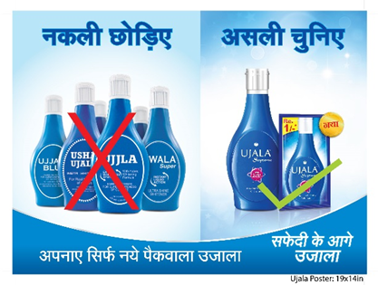
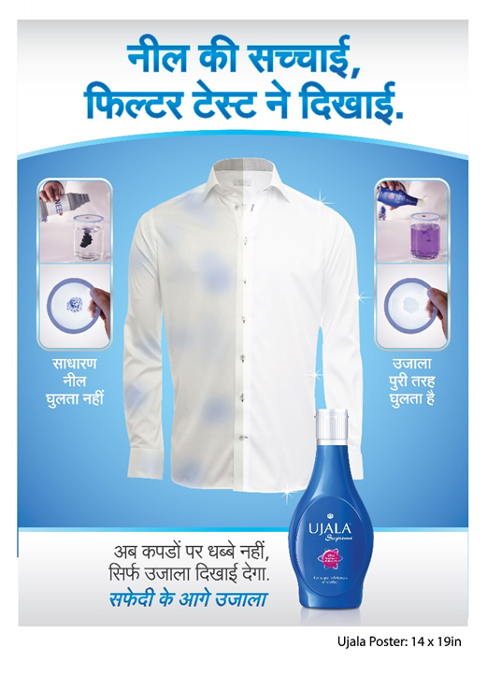
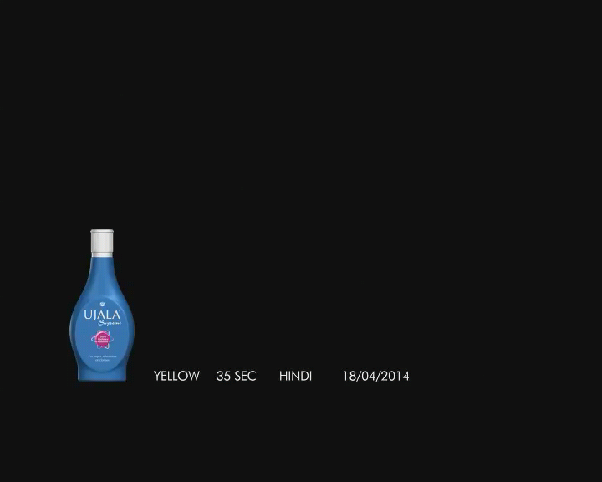

Updates
Media campaign on air to support brand
Strong on ground support
Proposition
Anti Yellow in Ujala Dominant states
Anti Low cost Neel in relevant pockets

Slide 17




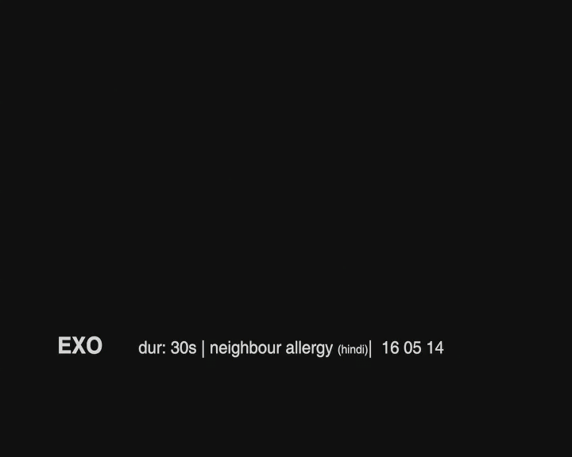
Updates
Brand Restaged with a strong Celeb Led campaign on the Anti Bac Platform
Exo Anti Bac scrubbers launched

Slide 18

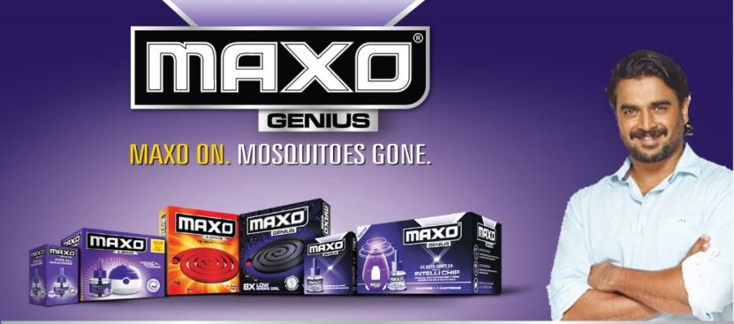
Maxo
Updates
Launch of Low Smoke Coil – JQ 2014
Innovation on LV: All new Mix to be launched in DQ 2014

Slide 19


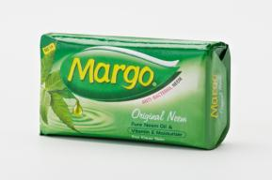
Margo
Updates
Core Continues to get strong Media Support
Face Wash Ready for launch in September 2014

Slide 20

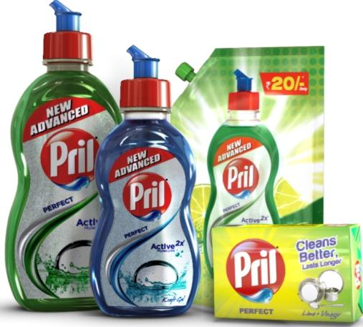
Relaunch : August 2014
Best Ever formulation for superior Grease cutting
Launch of All New Variant ( Kraft Gel )
Focus on Current White spaces for brand :
225 ml bottle & pouches for early category adopters

Slide 21


Slide 22

Henko LINTelligent A Revolution in Detergents Category
For years the detergent category only recognized stains and blotches as the main threat to clothes, while repeatedly ignoring the safety, shine and life of the clothes. As a result ordinary detergents could not keep up with the changing trends and dynamics in the fashion, apparel and lifestyle category.
Have you ever wondered how your clothes get dull and begin to fade after just a couple of washes?
The harsh enzymes, soda and bleach result in shredding of fibres during the wash these broken fibres are called LINT.
LINT on your clothes traps dirt and stains leaving them dull, rough and faded.
Henko discovered a revolutionary solution with Nano Fibre Lock technology to all your clothes problems, including, colour loss, fading and stain removal. The powder is pink in colour, while the texture is soft and smooth with a fine perfume scent that gives you a whole new washing experience while giving your clothes a new look and protecting it from ageing.

Slide 23
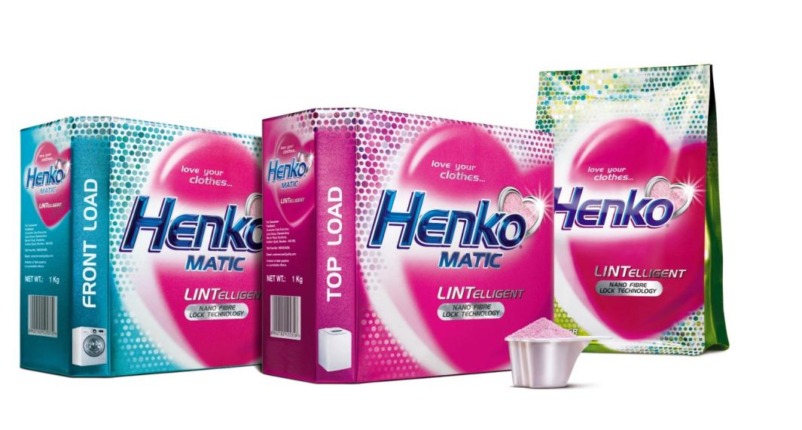

Henko matic Relaunched along with Top End Bucket Wash Variant
All India launch :
All > 1 lac towns Market storming
Outstanding visibility
Launch quantity aimed at grabbing 20% segment share of shelf in matics and 10 % share of shelf in Super Premium Handwash powders

Slide 24
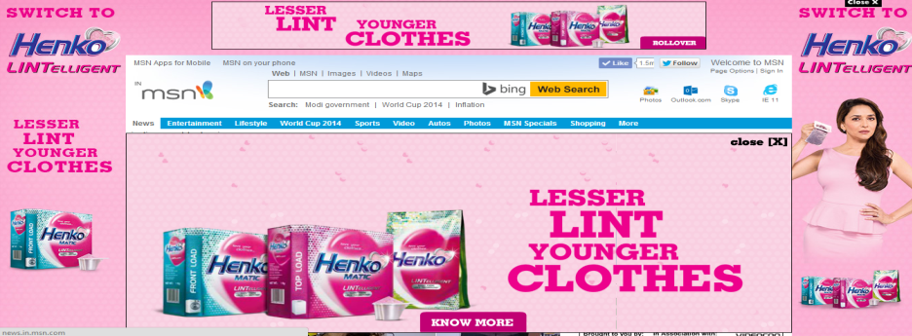
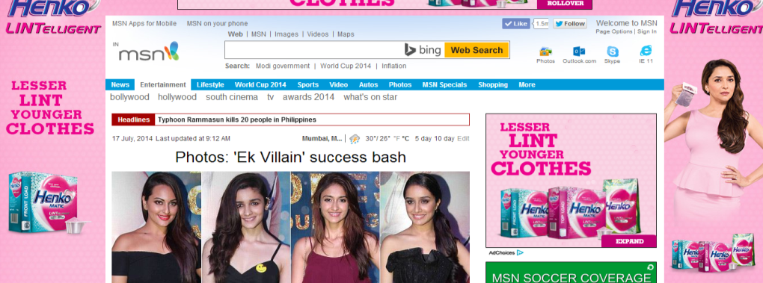
Strong Digital Campaign

Slide 25

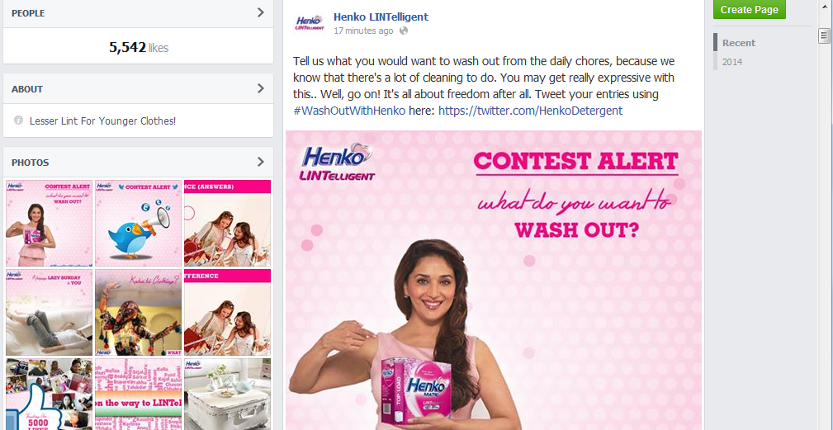

Slide 26

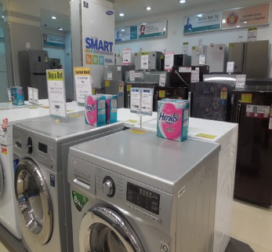
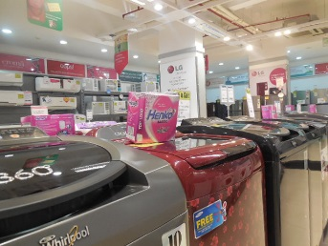
On Ground Tie Ups

Slide 27
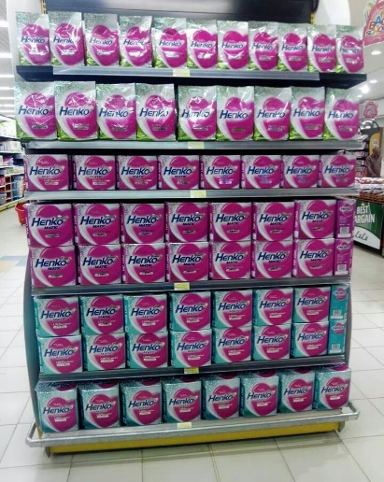
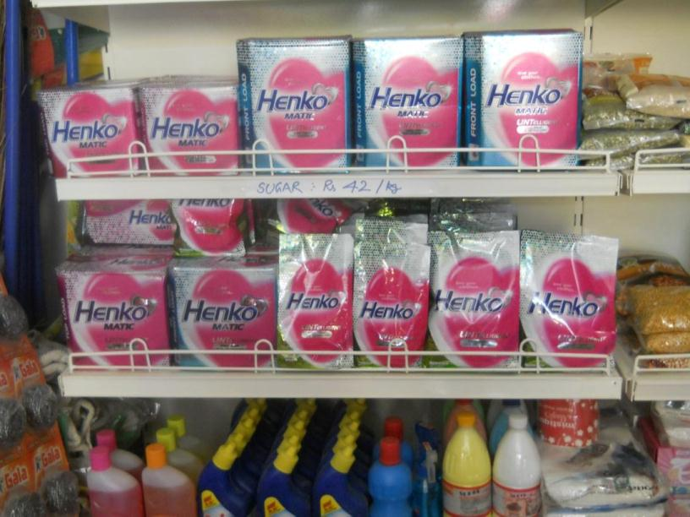
Modern Trade & A-Class outlets launch display

Slide 28
Thank You
Notes:
Outline differentiation/competetive strategy

